Slide 1
2. Initial settings
Windows Server 2019 Basics

Slide 2
Steps
Set networking settings
Change computer name
Configure Firewall rules
Enable Remote Desktop
Set Time Zone

Slide 3
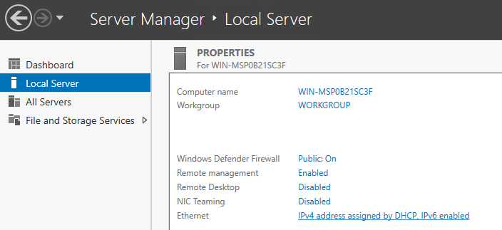
Set networking settings
Notes:
You can see a list of network adapters on the Local Server page of the Server Manager. In my case there is only one NIC named Ethernet. Clicking on it will bring up the Network Connections window.

Slide 4
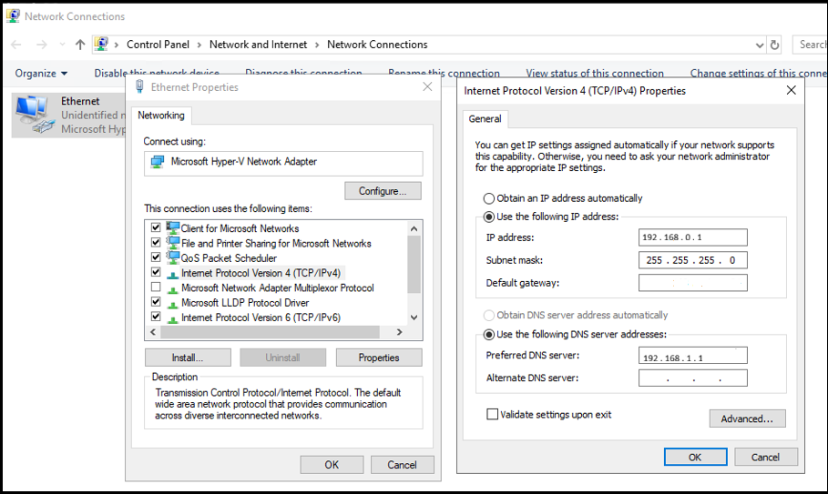
Set networking settings
Notes:
To configure the settings for a network adapter just right click and press Properties, then open Internet Protocol Version 4 (TCP/IPv4) and set your IP, Gateway and DNS servers . But In this case we don‘t have a gateway.

Slide 5
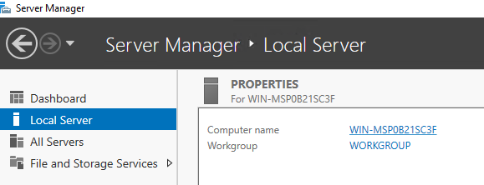
Change computer name
Notes:
To set a server’s name just click on the current name from the Local Server tab of the Server Manager.

Slide 6
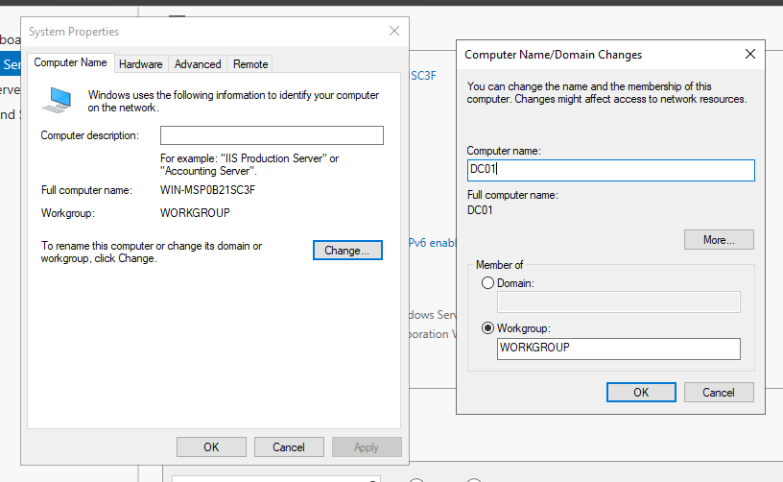
Change computer name
Notes:
Click on the Change button and enter the new computer name. In order for the changes to take effect the computer must be restarted.

Slide 7
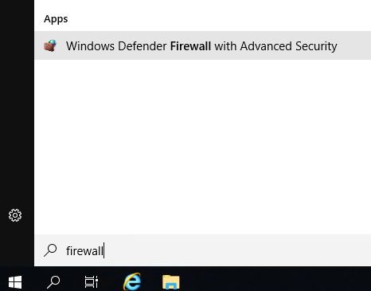
Configure Firewall rules
Notes:
The fastest way to open the Firewall console is to search for it in the Start Menu and opening Windows Firewall with Advanced Security.

Slide 8
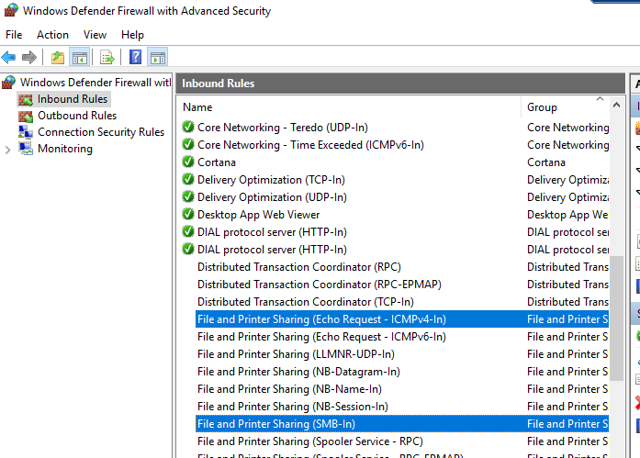
Configure Firewall rules
Notes:
The 2 inbound rules that I always configure are:
- File and Printer Sharing (Echo Request – ICMPv4-In) This is the rule that enables Ping
- File and Printer Sharing (SMB-In) This rule enables file sharing
Just right click and press Enable to activate the rules.

Slide 9
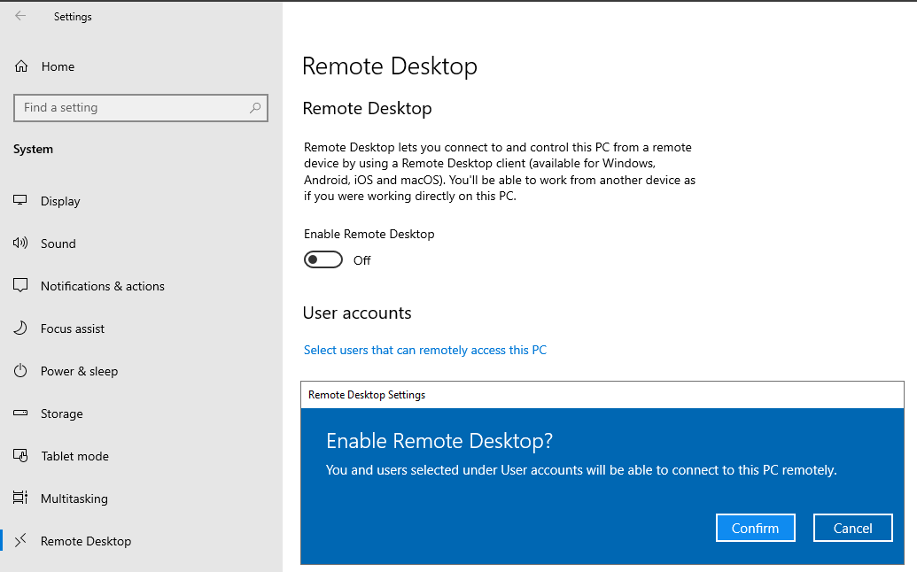
Enable Remote Desktop
Notes:
To enable Remote Desktop just open Settings, go to the Remote Desktop tab and toggle the switch to enable it. Press Confirm on the dialog box.

Slide 10
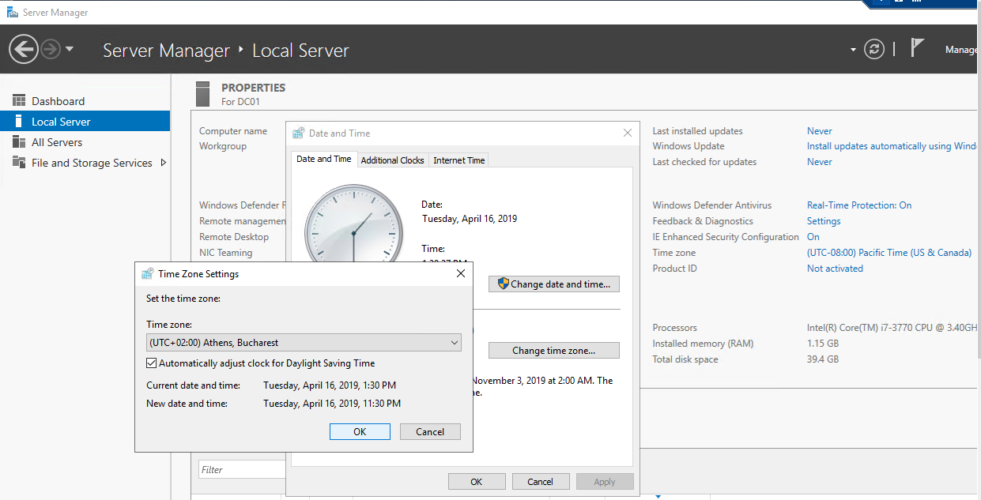
Set Time Zone
Notes:
The Time Zone settings can be easily accessed from the Local Server tab of the Server Manager by clicking on the current time zone. Click on the Change time zone button and select your location.

